Slide 1
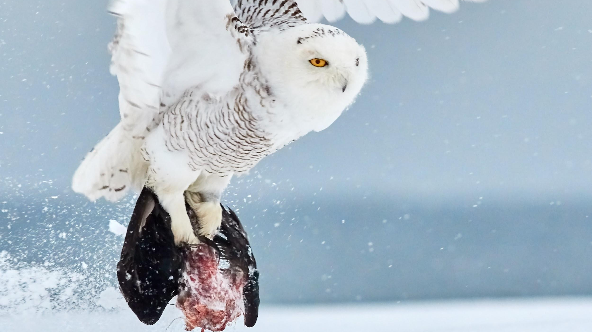
FOOD CHAINS
We will construct food chains to show feeding relationships.
Notes:
Insert cover image and use transparency settings to fade image.

Slide 2
Do not delete this slide.
This slide is designed so that you can copy the prompt box you need and insert it into your slides.
This slide is hidden and will not be included when presenting your lesson.
TRACK WITH ME
VOCABULARY
1 -
HINT
Students, remember….
CHECK FOR UNDERSTANDING
READ WITH ME
TEACHER CUE
MAKE THE CONNECTION
Students, you already know….
EXTENSION
GESTURE WITH ME

Slide 3
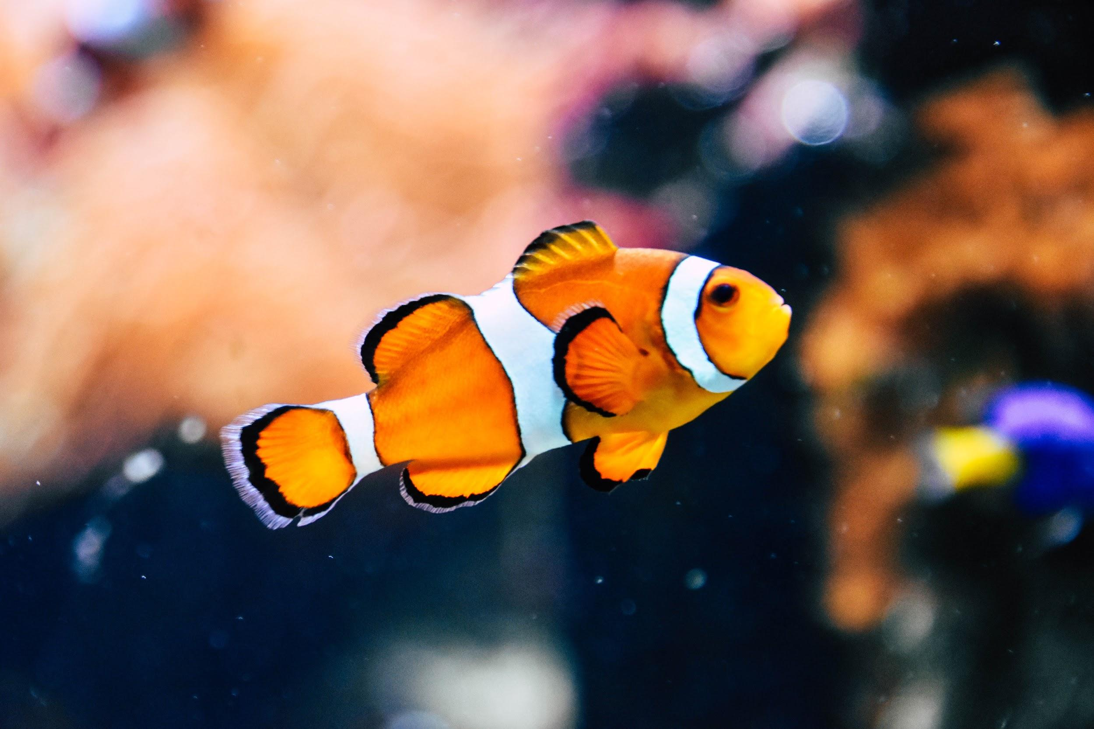
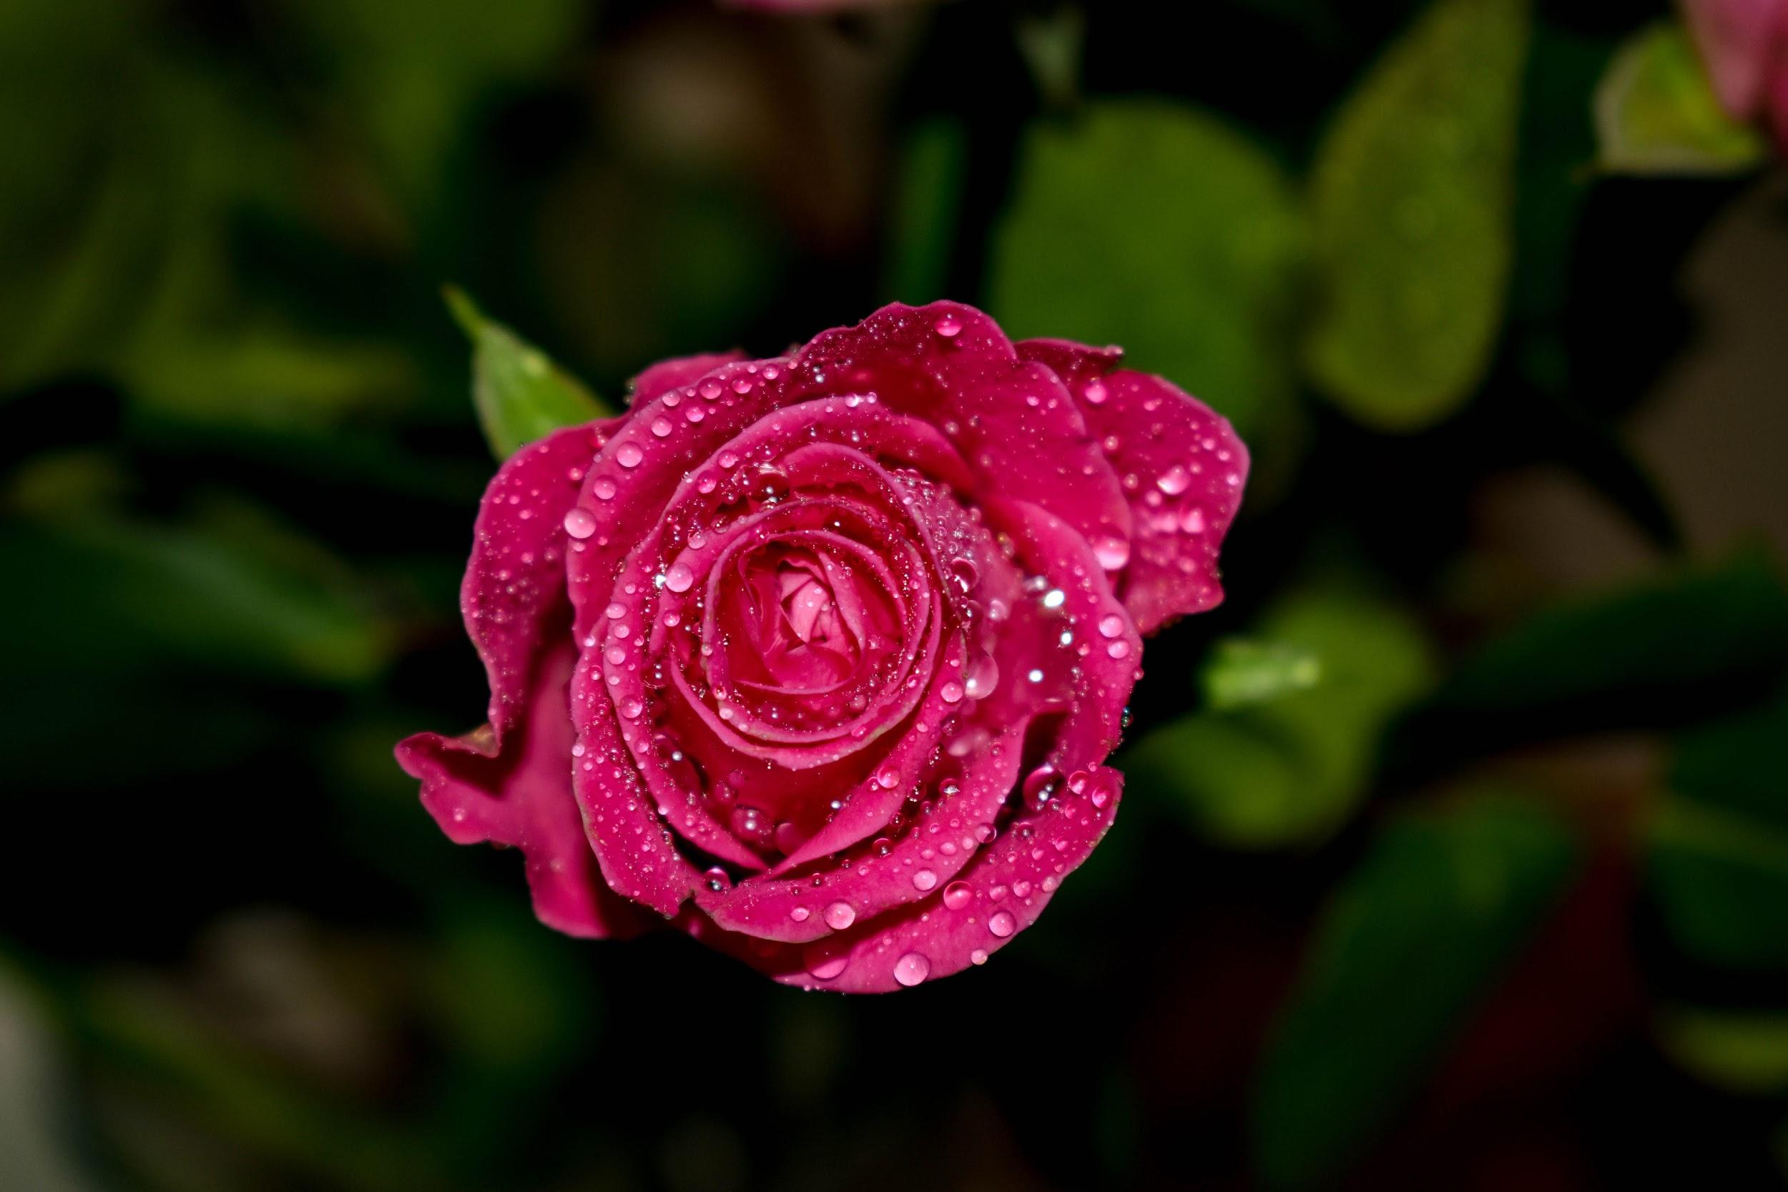
Write the scientific name for the two examples below:
Common name: Clown Fish
Kingdom: Animalia
Phylum: Chordata
Class: Actinopterygii
Order: Perciformes
Family: Pomacentridae
Genus: Amphiprion
Species: ocellaris
Common name: Dog Rose
Kingdom: Plantae
Phylum: Magnoliophyta
Class: Magnoliopsida
Order: Rosales
Family: Rosaceae
Genus: Rosa
Species: canina

Slide 4
Repeat the opposite word/phrase.
ORGANISM
LIVING THING

Slide 5
Repeat the opposite word/phrase.
CLASSIFICATION
SORTING BY CHARACTERISTICS

Slide 6
Repeat the opposite word/phrase.
VERTEBRATE
HAS A BACKBONE

Slide 7
Repeat the opposite word/phrase.
INVERTEBRATE
NO BACKBONE

Slide 8
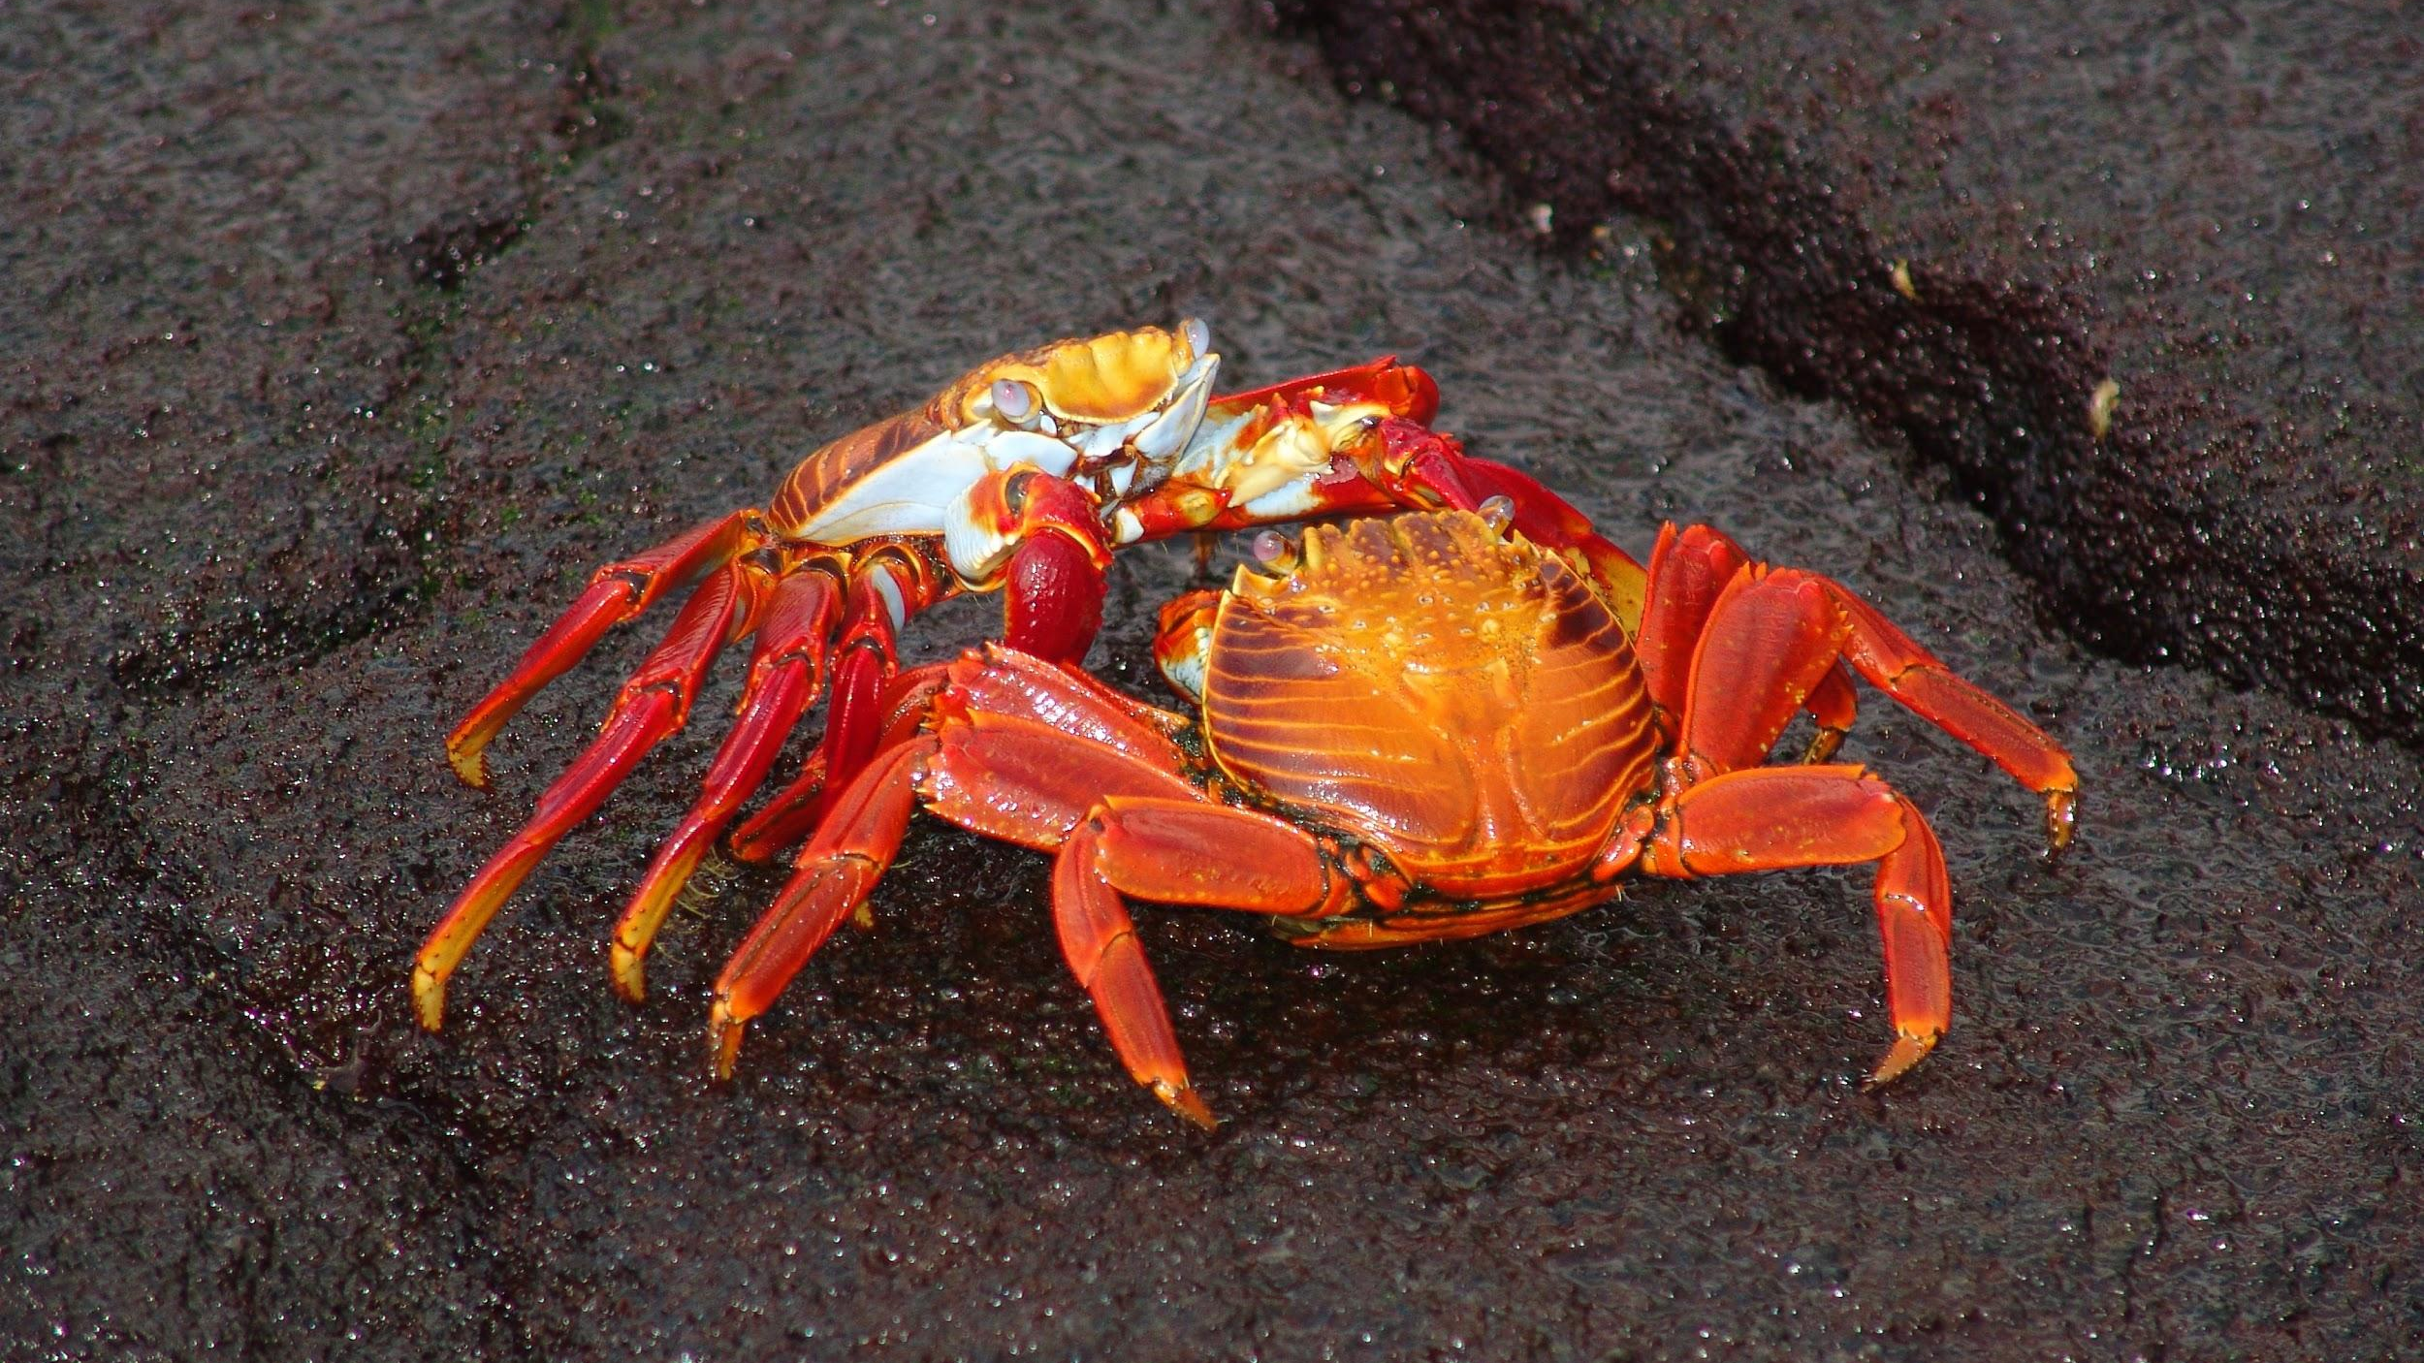
Repeat the opposite word/phrase.
EXOSKELETON
HARD BODY COVERING

Slide 9
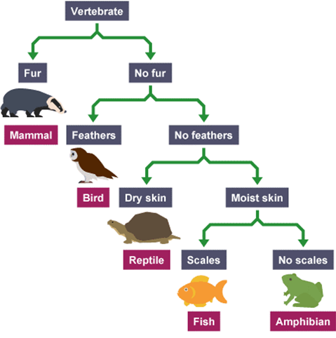
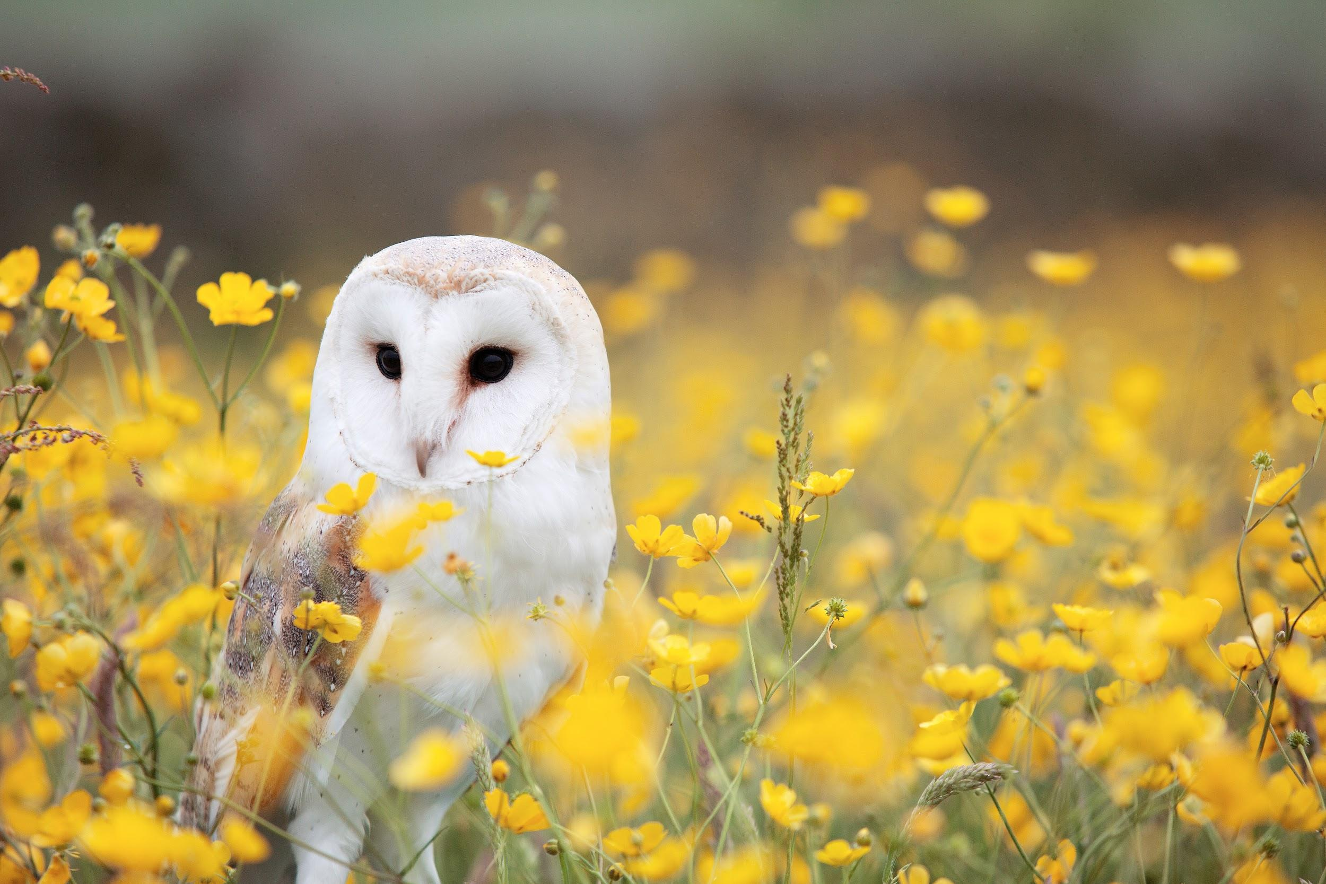
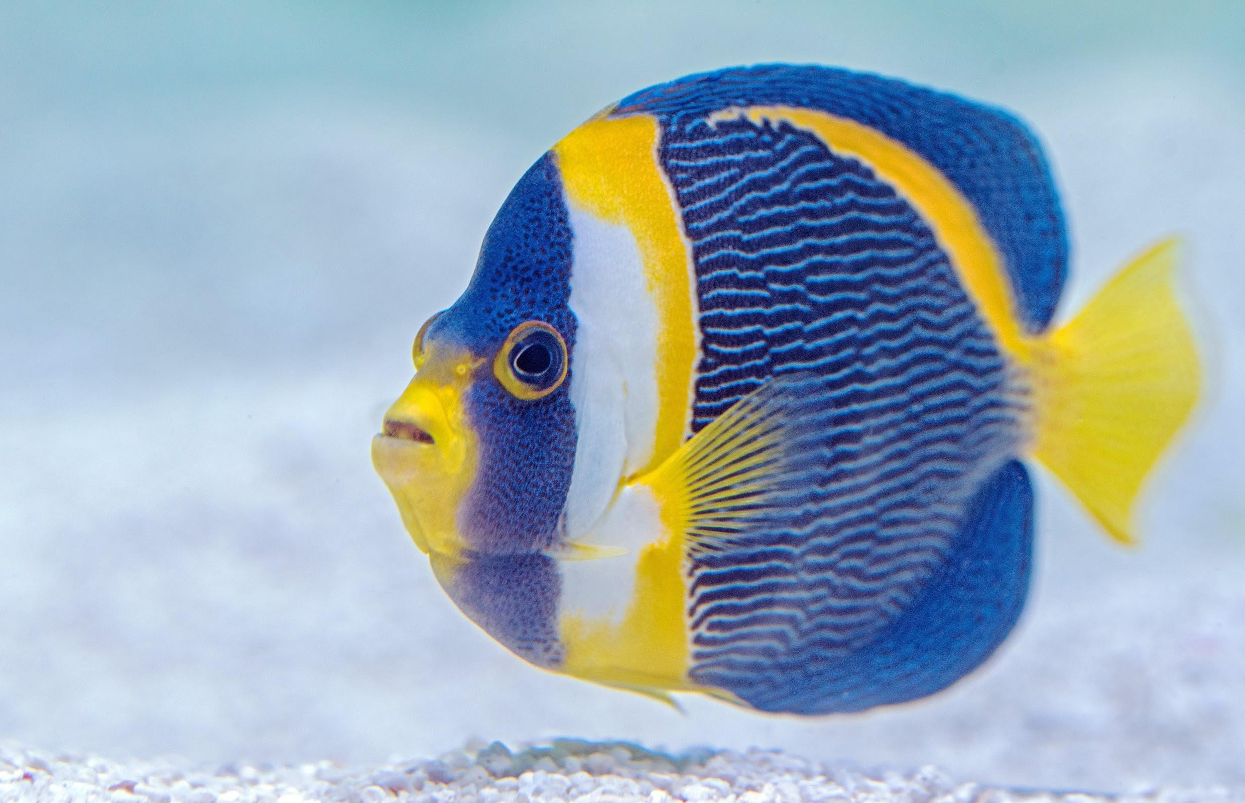
True or false:
Fish have moist skin
Owls are an invertebrate
Fish have exoskeletons
Owls do not have fur
Owl
Fish

Slide 10
What is one difference between a mammal and a bird?

Slide 11
We will construct food chains to show feeding relationships.
TRACK WITH ME
READ WITH ME
DECLARE THE OBJECTIVE
Read the learning objective to your partner.
We will define habitat.
We will define ecosystem.
We will define producer, herbivore, omnivore and carnivore.
We will classify organisms based on their position in a food chain.
We will use examples of ecosystems to construct food chains.
Notes:
Learning Objectives contain concepts (nouns, big ideas), skills (verbs, measurable behaviours) and sometimes context (restricting or targeting conditions).
●Example: Students will be able to describe the concept of density and apply it to floating and sinking.
●
Success criteria are specific measurable outcomes that if met mean that the student has met the learning objective.
Examples:
•Students will be able to compare densities of substances using mass and volume.
•Students will be able to identify whether a solid or liquid will float or sink in a liquid based on their densities.

Slide 12
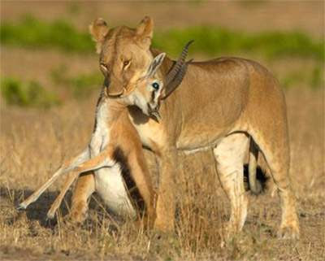
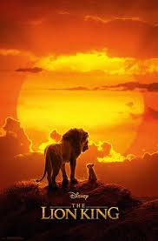
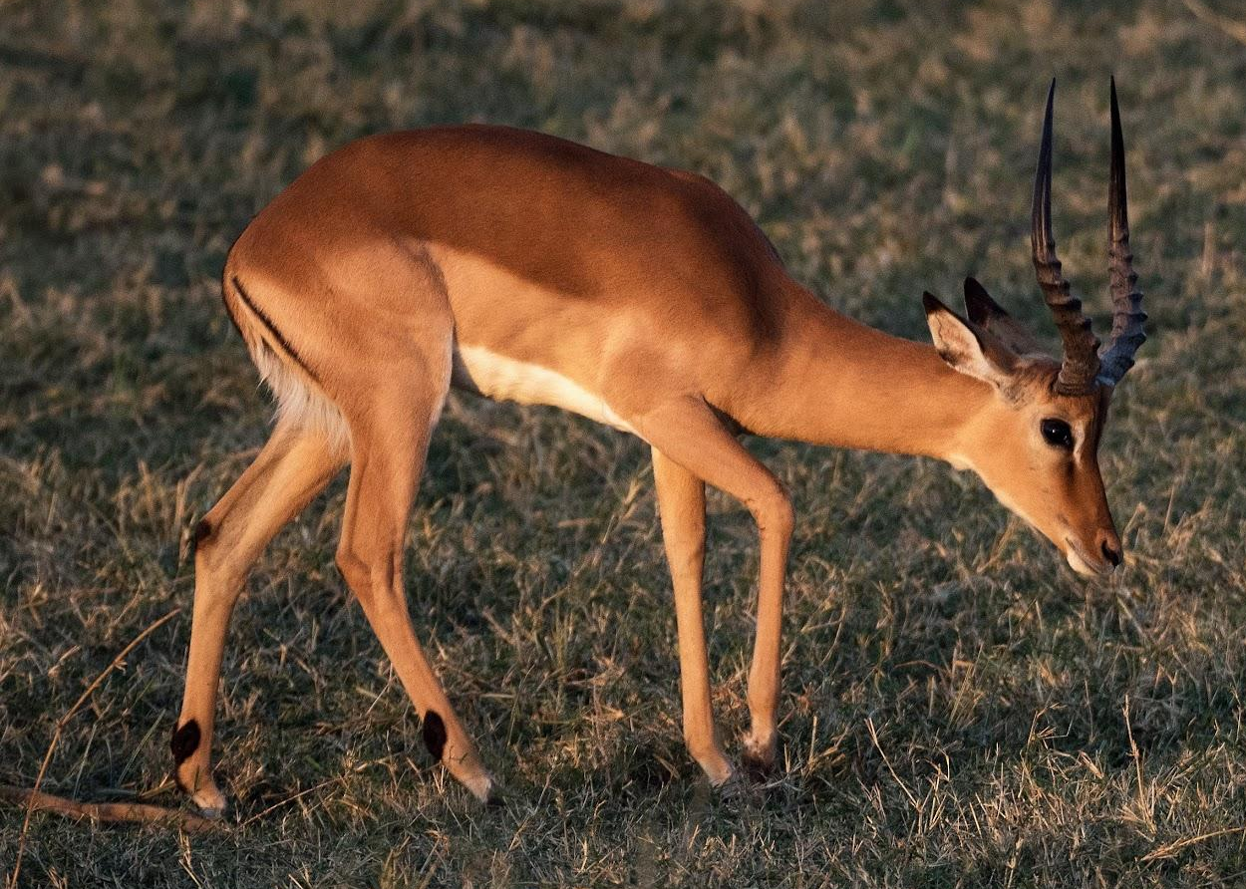
We will construct food chains to show feeding relationships.
We know that many living things need to eat other living things to get energy. What are some examples of this?
Mufasa: Everything you see exists together in a delicate balance. As king, you need to understand that balance and respect all the creatures, from the crawling ant to the leaping antelope.
Simba: But dad, don't we eat the antelope?
Mufasa: Yes, Simba, but let me explain. When we die, our bodies become the grass, and the antelope eat the grass. And so we are all connected in the great Circle of Life.

Slide 13
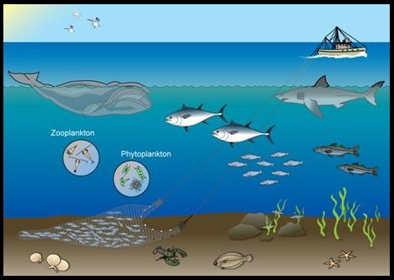
We will construct food chains to show feeding relationships.
An organism’s habitat is the environment it lives within.
An ecosystem is made up of all of the living and non-living things in an area.
We call a community of interacting₁ organisms and their physical environment an ecosystem.
The physical environment includes the sun, soil, water, rocks and air.
Ecosystems can vary in size from a tiny pool of water to hundreds of square kilometres of desert.
CHECK FOR UNDERSTANDING
Would this picture below be an ecosystem? Explain your answer.
VOCABULARY
1 - involved directly

Slide 14

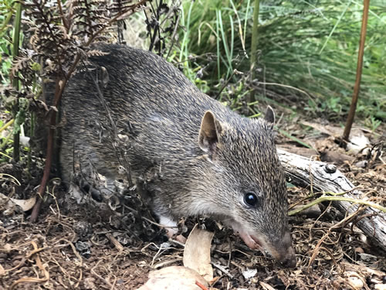
We will construct food chains to show feeding relationships.
Within an ecosystem:
Producers - Organisms that produce their own energy.
Examples: plants and algae
Consumers - Organisms that eat other organisms to get their energy.
Examples: animals
CHECK FOR UNDERSTANDING
Quenda’s eat insects, spiders, worms, plant roots, ferns, and fungi to get their nutrition. Would a Quenda be a producer or consumer?
VOCABULARY
1 - group

Slide 15
We will construct food chains to show feeding relationships.
Type | Term | Definition | Examples
Producer | Producer | Uses energy from the sun to make its own food | Plants (grass, trees, shrubs), algae (seaweed, plankton)
Consumer | Herbivore | Eat plants (producers) | Cows, snails, sheep, kangaroos
Consumer | Carnivore | Eat animals | Lion, shark, snake, spider
Consumer | Omnivore | Eat both plants and animals | Human, pig, rat, turtle, chicken
CHECK FOR UNDERSTANDING
What is the difference between an omnivore and carnivore?
Producer
Herbivore
Carnivore
Omnivore

Slide 16
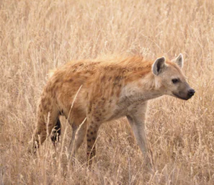
We will construct food chains to show feeding relationships.
In the Lion King the habitat that Simba lives in is the Pride Land (grass lands).
Some producers₁ in Simba’s Pride Land would be plants, grasses and trees.
Primary Consumers in the Pride Land are herbivores, or animals that eat only the plants and grasses. Examples of these animals are elephants, zebras and antelope.
Secondary Consumers are animals like cheetahs and hyenas that eat the zebras and other carnivores.
CHECK FOR UNDERSTANDING
Cheetas and hyenas only eat other animals. This makes them… Herbivores Omnivores Carnivores
VOCABULARY
1 - make their own food

Slide 17
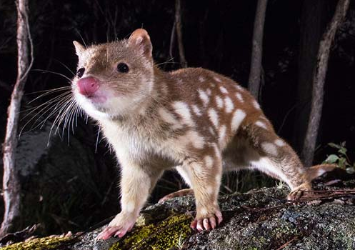
We will construct food chains to show feeding relationships.
Food chains show which organisms eat other organisms.
Grass → Rabbit → Fox
The arrows show the transfer of energy from one organism to the next.
Food chains always start with a producer.
We classify organisms based on their position in a food chain.
Primary consumers are animals that eat the producers (e.g. plants).
Secondary consumers are animals that eat the primary consumers (e.g. lion eating an antelope).
CHECK FOR UNDERSTANDING
What would the Quoll be? Producer Primary Consumer Secondary Consumer Tree → Insect → Quoll
Producers → Primary consumers → Secondary consumers

Slide 18
We will construct food chains to show feeding relationships.
Write down the food chains.
CHECK FOR UNDERSTANDING
__________ → __________ → ________
Grass is eaten by rabbits which are eaten by owls.
Plankton is eaten by shrimp which are eaten by fish.
Kelp is eaten by snails which are eaten by mackerel.
Flower nectar is eaten by butterflies which are eaten by honey eaters.
Leaves are eaten by ants which are eaten by echidnas.
HINT
Draw in arrows pointing from the thing being eaten to the thing eating it. This shows where the energy comes from

Slide 19
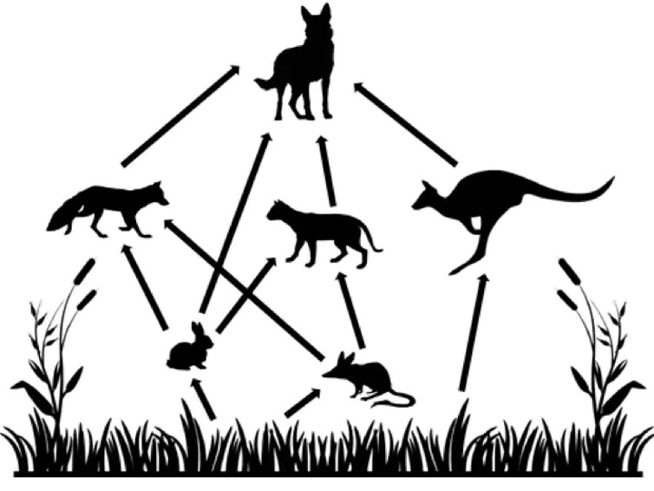
We will construct food chains to show feeding relationships.
Construct three food chains from this example of an Australian ecosystem.
Dingo
HINT
Draw in arrows pointing from the thing being eaten to the thing eating it. This shows where the energy comes from.
Fox
Kangaroo
Feral Cat
Bilby
Rabbit
TEACHER CUE
Model constructing one.
Grass
Grass

Slide 20
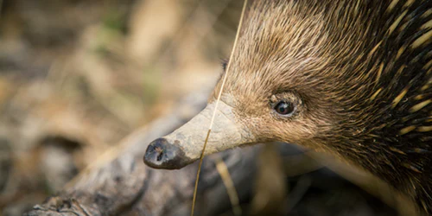
We will construct food chains to show feeding relationships.
Understanding food chains allows us to predict what will happen to organisms in an ecosystem if there are changes to the food chain.
If the amount of food available to an organism decreases, then generally the number of that organism will also decrease.
For example one third (⅓) of all the food we eat is pollinated by bees. Bees are disappearing globally at an alarming rate due to pesticides, parasites, disease and habitat loss. This could potentially reduce the amount of food we have available to eat.
CHECK FOR UNDERSTANDING
Leaves → Ants → Echidnas What do you think would happen to the number of echidnas on a bush property if the owner of the property sprayed the whole property for ants and afterwards the amount of ants dropped to almost none?

Slide 21
We will construct food chains to show feeding relationships.
A food chain is a series of organisms that eat one another, so that energy and nutrients flow from one organism to the next.
Because of this food chains show the flow of energy, nutrients and matter through an ecosystem.
At the base of the food chain are the producers such as plants or algae. These organisms make energy that is transferred onto the herbivores that eat them (primary consumers).
Carnivores eat animals, and omnivores eat plants and animals.
CHECK FOR UNDERSTANDING
In this food chain identify the 1. Producer 2. Carnivore Grass → Bilby → Fox

Slide 22
We will construct food chains to show feeding relationships.
Classify these organisms as a producer, primary consumer or secondary consumer.
Identify the herbivores and carnivores.
HINT
Producers produce their own food. Primary consumers eat producers. Secondary consumers eat primary consumers. Herbivores eat plants. Omnivores eat plants and animals. Carnivores eat animals.
Grass → Rabbit → Fox
Grass → Bilby → Feral Cat
Grass → Kangaroo → Dingo
Plankton → Shrimp → Fish
Kelp → Snail → Mackerel
Flower nectar → Butterfly → Honey Eater
Notes:
Please include tasks/questions here rather than just referring to a worksheet. This will save on photocopying and facilitate sharing with other schools.
Try and build tasks/questions which escalate through Bloom’s Taxonomy. This will help with differentiation.

Slide 23
We will construct food chains to show feeding relationships.
CHECK FOR UNDERSTANDING
Check Success Criteria.
We will define habitat.
We will define ecosystem.
We will define producer, herbivore, omnivore and carnivore.
We will classify organisms based on their position in a food chain.
We will use examples of ecosystems to construct food chains.

